Slide 1
Gifts from the Vrijmoed’s
When Christine’s parents began supporting us ﬁnancially in 2004, they intended to help us build a stable home together. From 2004 through 2009, they contributed approximately HK$4 million, which went directly to the mortgage and other family expenses. Importantly, these contributions were not presented with any indication of debt or repayment; they were designated as “support” or “mortgage payment,” reﬂecting their role as family gifts to help Christine and me establish a home.
The Original Intent: Family Support, Not Debt
From the beginning, the language around these contributions was straightforward. In every instance, Christine’s parents referred to their ﬁnancial support as help for the mortgage, never as loans. This characterization was conﬁrmed by a critical email on January 14, 2007. Christine’s father explicitly stated, “There is no debt,” and addressed Christine and me as “the only owners” of our home. This was not a minor remark but a clear statement of intent, reinforcing that these funds were gifts, free of any repayment obligation or strings attached.
This statement, made after years of contributions, sets a clear precedent: Christine’s parents viewed their ﬁnancial support as an investment in our shared future, not as a personal debt owed by Christine. They intended for us to use these funds to reduce our mortgage burden, build equity, and strengthen our family’s ﬁnancial position, with no expectation of repayment.
Consistent Language and Documentation from 2004 to 2009
Between November 5, 2004, and January 11, 2007, Christine’s parents contributed roughly HK$1.48 million, all documented as informal family support without any mention of loans or repayment terms. Every transaction followed this pattern, with contributions directed to our joint accounts and used for shared expenses like our mortgage. This period reﬂects a straightforward, transparent approach where the family’s intention was never questioned. There were no loan agreements, interest charges, or repayment schedules, all of which would have indicated a loan, not a gift.
As documented from 2004 through 2009, the evidence shows that everyone involved understood and treated these funds as gifts to support our shared home. We made countless ﬁnancial decisions during these years, relying on this understanding, which shaped our lives, from budgeting to planning for the future. I thanked her Dad for these gits and the impact they made.
The 2010 Reclassiﬁcation as “Interest-Free Loans”
In 2010, however, Christine’s parents retroactively began to reframe these past contributions as “interest-free loans” against Christine’s inheritance. This was the ﬁrst time that terms like “inheritance deduction” and “loan” entered the conversation. They created “Pro Memos” and balance sheets that attempted to formalize a new understanding of these contributions, marking them as debt rather than the gifts they had initially been.
III.

Slide 2
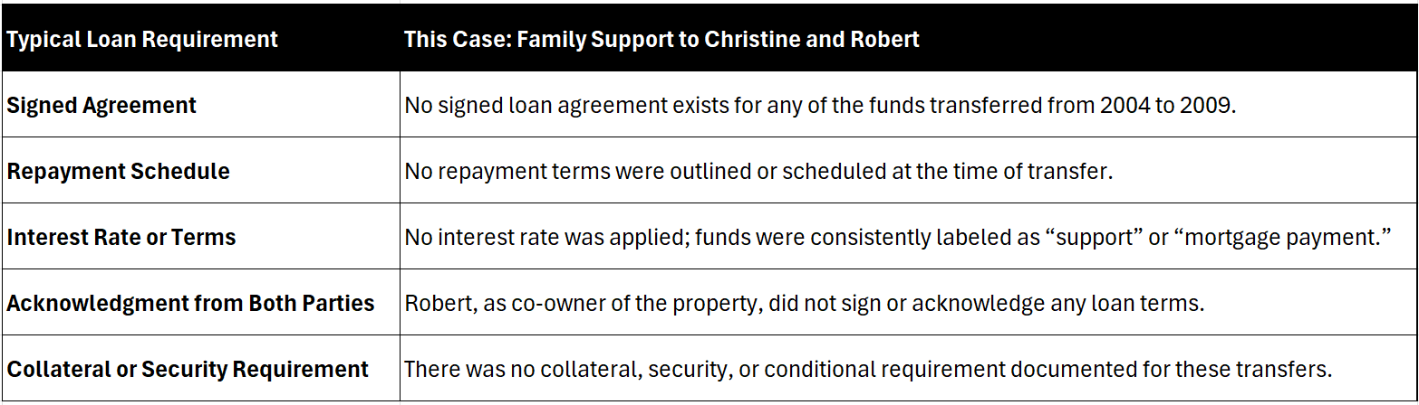
This reclassiﬁcation was not supported by any loan documentation typical of such transactions— no signed agreements, interest rates, agreed-upon repayment schedules, and, importantly, no conversation or consent from both parties who had relied on these funds as gifts. This abrupt shift contrasts with the previous six years of consistent treatment as gifts. It disregards the shared ownership and mutual reliance on these contributions as part of our community property.
The timing of this reclassiﬁcation is highly questionable, as it only occurred long after the funds had been given and spent on shared assets. We had built a life and made ﬁnancial decisions based on the assumption that these contributions were non-repayable support for our family, which Christine’s father explicitly acknowledged in 2007. Changing this understanding three years later is inconsistent and unfair, as it retrospectively alters the foundation of our shared ﬁnancial planning.
IV. Legal and Equitable Implications
If the court were to uphold this reclassiﬁcation as loans against Chrisitne’s inheritance, it would create an inequitable situation where funds given freely to support our family and reduce our mortgage burden would now serve to reduce my share of our jointly owned property. This reclassiﬁcation attempts to change the nature of community property by transforming shared support into a separate debt, to my detriment. Additionally, Washington State’s community property principles favor assets and contributions to marriage being jointly owned and equitably shared, which supports treating these funds as community gifts rather than individual debts. This would infer that Christine secretly owned 25% more equity than me, which is not the case and would be unfair.
So, I am challenging this reclassiﬁcation as contrary to the contributions' original intent and the practical realities of how they were used. Christine’s parents had years to deﬁne these funds as loans but chose to characterize them as support and gift contributions toward our shared home instead. The retrospective attempt to reclassify them undermines the principles of fairness and equitable division that guide Washington’s community property laws and threatens to alter the distribution of assets in our case unfairly.

Slide 3
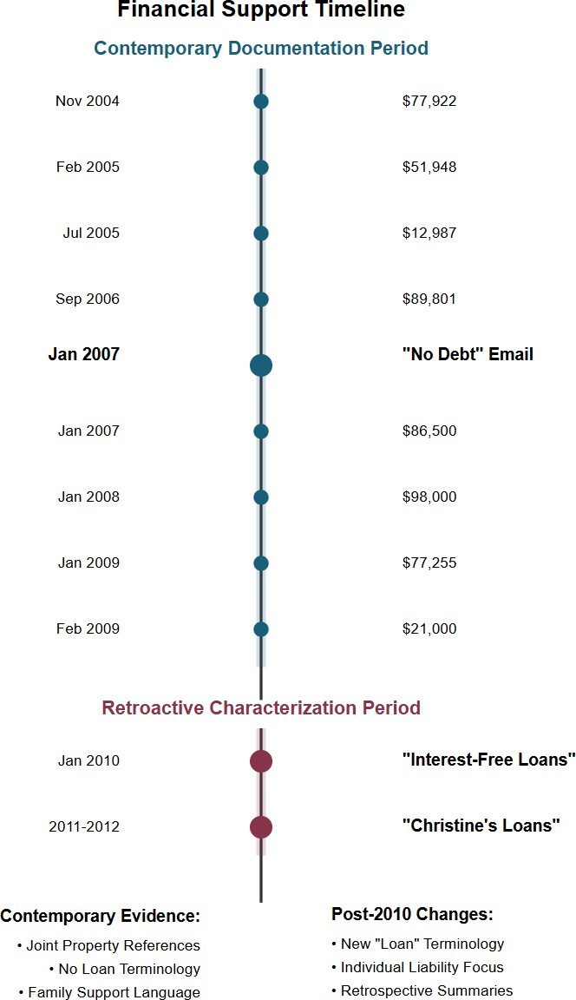
V. Conclusion: Honoring the Original Intent and Protecting Community Equity
The attempt in 2010 to reframe these contributions as loans are inconsistent with the original intent, lacks any of the formal indicators of a loan, and threatens to unjustly alter the division of our jointly owned property. The timeline and documentation from 2004 to 2009 present a consistent, clear picture: Christine's parents' contributions were gifts intended to beneﬁt our family and our shared home without repayment expectations. I respectfully request that these funds be recognized as gifts, consistent with their original purpose and the mutual reliance they supported so that our family’s shared assets can be divided fairly and equitably.

Slide 4
Appendix
Annotated Timeline of Key Shifts in Language and Documentation
2004-2009: Family Support and Gift Characterization
November 5, 2004: Initial transfer of HK$600,000 described as “support” or “mortgage payment.”
February 2, 2005 - January 11, 2007: Additional transfers totaling around HK$1.48 million. All transactions use informal support language and show no indication of loan terms.
January 14, 2007 Email: Christine’s father explicitly states, “There is no debt,” and addresses both “Robert and you” as “the only owners” of the house. This email shows that these funds were intended as gifts without repayment obligations.
2010: Reclassiﬁcation as “Interest-Free Loan”
January 22, 2010 Email: This marks the ﬁrst documented appearance of “interest-free loan” terminology. The email from Christine’s father includes retrospective “Pro Memos” and balance sheets that refer to prior gifts as “interest-free loans” for the ﬁrst time.
Balance Sheets and Pro Memos (2011-2012): These summaries introduce terms like “inheritance deductions” and attempt to formalize the reclassiﬁcation. However, they lack the formal features of a genuine loan and are created after the fact to change the original understanding of these funds.
Pre-2010 Consistency vs. Post-2010 Reclassiﬁcation
Pre-2010 Language: The documentation from 2004 to 2009 consistently uses terms like “support” and “mortgage payment” without any mention of loans.
Post-2010 Language: In contrast, the 2010 documentation shift introduces more formal, accounting-oriented terms—“interest-free loan” and “inheritance deduction”— indicating an apparent narrative change rather than a continuation of the original family intent.
This structured comparison and annotated timeline comprehensively respond to Christine’s argument. The absence of loan standards, combined with the shift in language only in 2010, strongly supports Robert’s position that these funds were originally family gifts. The checklist and timeline reinforce that these were intended as informal support, without repayment obligations, and that the reclassiﬁcation does not align with the original intent. Please see the additional visual representation on the following page.
Gifts Conveniently Transform to Loans Between Christine and Me

Slide 5
Emails Between Christine and Robert
Medical Benefit Letter
11 messages
christine moyer <christinemoyer@hotmail.com>
To: "rob.moyer@gmail.com" <rob.moyer@gmail.com>
Wed, Dec 27, 2023 at 8:32 AM
Hi Robert,
I believe you need this letter to submit to Premera to get the refund for insurance premium. Let me know if they need anything additional.
Christine
Moyer Letter.pdf
'C J 762K
Rob Moyer <rob.moyer@gmail.com>
To: christine mayer <christinemoyer@hotmail.com>
Wed, Dec 27, 2023 at 8:37 AM
Thanks! Will do.
fwiw- I know the path we are on. But please feel free to be less formal in your corns. We will share three kids for the rest of our lives. So the tone as if I'm a coworker is a bit awkward. After you note yesterday, I realize tone is important in this partnership.
From: christine moyer <christinemoyer@hotmail.com>
Sent: Wednesday, December 27, 2023 8:32 AM
To: rob.moyer@gmail.com <rob.moyer@gmail.com>
Subject: Medical Benefit Letter
[Quoted text hidden]
christine moyer <christinemoyer@hotmail.com> To: Rob Moyer <rob.moyer@gmail.com>
Wed, Dec 27, 2023 at 8:39 AM
Ok. Any progress on refund from Beth?
I'm going to look at unemployment benefits today and see how we can move that. Get Outlook for iOS
From: Rob Moyer <rob.moyer@gmail.com>
Sent: Wednesday, December 27, 2023 8:37:24 AM
To: christine mayer <christinemoyer@hotmail.com>
Subject: Re: Medical Benefit Letter
[Quoted text hidden)
Rob Moyer <rob.moyer@gmail.com>
To: christine mayer <christinemoyer@hotmail.com>
Wed, Dec 27, 2023 at 8:46 AM

Slide 6
Refund- I got the 3k as requested, plus some other for the boys. I'll set up a Bofa like you and move it over.
Unemployment- I am a couple weeks behind because we were not doing anything, but I will get caught up.
Vrijmoeds- There were delays and hiccups on the last gift. Was that finalized, or is there anything outstanding?
[Quoted text hidden)
christine moyer <christinemoyer@hotmail.com> To: Rob Moyer <rob.moyer@gmail.com>
Wed, Dec 27, 2023 at 8:52 AM
Ok. The 3k was for the first trip for expenses. I thought you covered prescriptions that were 1k plus and other trip expenses for helping out with surgery on subsequent trips?
I don't know what you are referring to on Vrijmoed gifts? Get Outlook for iOS
From: Rob Moyer <rob.moyer@gmail.com>
Sent: Wednesday, December 27, 2023 8:47 AM
[Quoted text hidden] [Quoted text hidden)
Rob Moyer <rob.moyer@gmail.com>
To: christine moyer <christinemoyer@hotmail.com>
Wed, Dec 27, 2023 at 8:57 AM
The trip was 2k. The Rx was lK. That is a total of 3k. That was what we discussed. It is in our running list since it began.
Your mom and Dad gave us another gift (I think it was in the spring). They gave it to all three of the kids. Uncle Mark even brought it up when he was here. Then you kept telling me that your mom was doing things with part of it and would get the rest of it to us later. We had that discussion prior to July s^{th} many times. I am surprised that you do not remember their last gift to us. You really don't remember?
From: christine moyer <christinemoyer@hotmail.com>
Sent: Wednesday, December 27, 2023 8:52 AM
To: Rob Moyer <rob.moyer@gmail.com>
[Quoted text hidden]
[Quoted text hidden)
christine moyer <christinemoyer@hotmail.com> To: Rob Moyer <rob.moyer@gmail.com>
Wed, Dec 27, 2023 at 9:08 AM
07/27/2023 | WIRE TYPE:INTL IN DAT :230727 TIME:0425 ETTRN:XXXXXXXXXX1464l 1... View/Edit | Credi! | $3.750.00
07/14/2023 | WIRETYPE:INTL IN DATE:230714 TIME:0422 ETTRN:XXXXXXXXXX017670... | Credi! | $10,000.00
 | View/Edit
07/13/2023 | WIRETYPE:INTL IN OATE:230713 TIME:0428 ETTRN:XXXXXXXXXX102245... | Credit | $10,000.00
 | View/Edit
03/09/2023 | WIRE TYPE.INTL IN DATE.230309 TIME:0435 ETTRN.XXXXXXXXXX094308... | Credi! | $9,000.00
 | View/Edit
03/08/2023 | WIRE TYPE.INTL IN DATE.230308 TIME:0429 ET TRN:XXXXXXXXXXl 59167,~ |  | $9.000.00
 | View/Edit
02/2812023 | WIRE TYPE INTL IN OATE.230228 TIME:0437 ET TRN XXXXXXXXXX091376. V1ew/Ed1t | Credit | $7.620.00

Slide 7
From: Rob Moyer <rob.moyer@gmail.com>
Sent: Wednesday, December 27, 2023 7:57 AM
[Quoted text hidden]
[Quoted text hidden)
christine moyer <christinemoyer@hotmail.com> To: Rob Moyer <rob.moyer@gmail.com>
Wed, Dec 27, 2023 at 9:09 AM
It was all transferred.
From: christine moyer <christinemoyer@hotmail.com>
Sent: Wednesday, December 27, 2023 8:08 AM
[Quoted text hidden]
[Quoted text hidden)
Rob Moyer <rob.moyer@gmail.com>
To: christine moyer <christinemoyer@hotmail.com>
Wed, Dec 27, 2023 at 9:16 AM
Got it.
Was this the full expected total equivalent to your siblings or just the part before you went to Hong Kong and discussed me with your Mother?
Not trying to be difficult at all, but I just want to be sure I am asking the right question because they all stopped after Hong Kong. Thanks again.
[Quoted text hidden]
christine moyer <christinemoyer@hotmail.com> To: Rob Moyer <rob.moyer@gmail.com>
Wed, Dec 27, 2023 at 9:20 AM
This is the full amount that went to all siblings.
Btw my running total for Bend trips before I stopped tracking was more than the 3k. One plane ticket alone was 750, add in hotel for multiple stays plus other airline tickets, but if that's your number. I can go back and add up if you want.
Get Outlook for iOS
From: Rob Moyer <rob.moyer@gmail.com>
Sent: Wednesday, December 27, 2023 9:16:10 AM
[Quoted text hidden]
[Quoted text hidden)
Rob Moyer <rob.moyer@gmail.com> To: Rob Moyer <rob.moyer@gmail.com>
Sat, Jun 22, 2024 at 8:18 PM
Refund
[Quoted text hidden]

